Slide 1
Conversion of a Color to a Greyscale Image (using Pthreads & MPI)
Final Presentation
Aditya Mulampally

Slide 2
Introduction
Motive of the project is the speeding up of the conversion process using parallelization.
A bmp file format of image was chosen for this project.
A bmp or bitmap image is an image format capable of storing 2-D image.
Notes:
Tell line about conversion

Slide 3
A Look Inside BMP file Format
BMP file format has the following
BMP File Header
BMP Info Header
The file header mainly gives info regarding file size and the starting point of the pixel values.
The info header gives information regarding width, height, compression type.

Slide 4
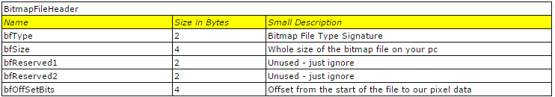
Bitmap File Header

Slide 5
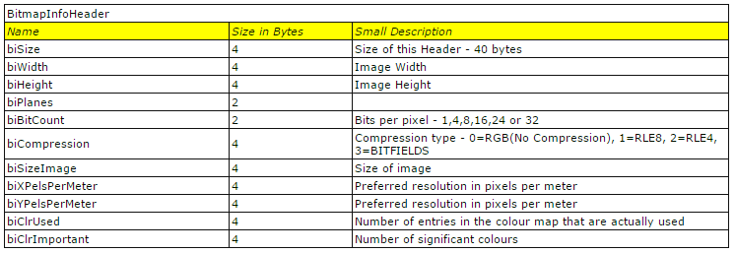
Bitmap Info Header

Slide 6

Parallelism Depiction
Thread 1 ->
Thread 2 ->
Thread 3 ->
Thread 4 ->

Slide 7

Output + Formula For Conversion
((0.30 *r)+(0.59 *g)+(0.11* b))/3

Slide 8
PThreads
A.K.A POSIX Threads.
This allows us to control multiple workflows within the same program.
Workflows are known as “threads”
Main parts of the program
pthread_create
pthread_join
compute_parallel

Slide 9
Code
Will be shown in IDE

Slide 10
MPI
Stands for Message Passing Interface
Multiple nodes on the network can collectively work together to perform the task.
Each CPU on the network can perform an individual task so that the overall performance is maximized
MPI can target both shared and distributed memory systems.

Slide 11
Code
Shown in the IDE.

Slide 12
Batch File
#!/bin/bash
#PBS -N final
# name you want to give your job
# the default output file will use this
#PBS -q batch
# specify the queue you want to use
#PBS -l nodes=2:ppn=12
# request 2 nodes w/12 processors per node
#PBS -l walltime=1:00:00
# request ONE hour of walltime. your job will be killed if it goes over.
# Your job will start sooner, the shorter the walltime.
# #PBS -m abe -M aditya.mulampally@okstate.edu
# send me email when job aborts, begins and exits
#PBS -j oe
# join the output in error file into one file
cd $PBS_O_WORKDIR
# change to current working directory
module load openmpi-1.4/intel
# set environment variables to use the correct mpi implementation
NP=`cat $PBS_NODEFILE | wc -l`
# calculate the total number of processors requested
mpirun -np ${NP} ./main2
# run mpi code on NP processors

Slide 13
OpenMP
Short form for Open Multi Processing.
It targets only Shared Memory Systems.
It is hooked only with the gnu complier. Hence it has only specific implementation.
Fairly easy to implement.

Slide 14
Code
Shown in the IDE

Slide 15
Pthreads vs MPI
Pthreads is more complicated to implement, as the programmer has to specify the function where parallel processing has to be done.
In MPI the entire program is treated as parallel, and it is also easier to implement MPI as compared to Pthreads.
MPI is based on the function calls from the api.
OpenMP is implemented using #pragmas followed by the keywords which do the task.

Slide 16
Performance Comparison
I have mainly taken 2 images to compare the performance.
1st image is of the size 27 MB
2nd image is of the size of 242 MB
I obtained the time for the serial code, Pthread implementation, MPI with varying the amount of threads, OpenMP with varying the amount of threads.

Slide 17
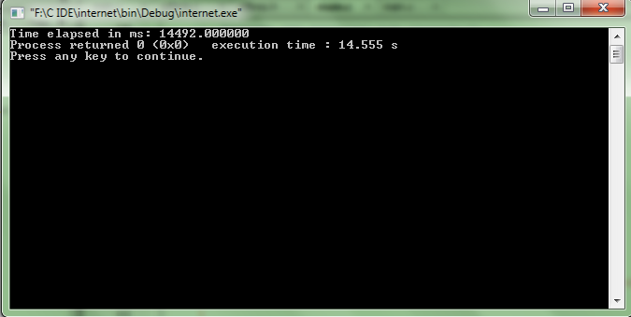
Serial Time
242 Mb
27 Mb

Slide 18



Pthreads Implementation
2 threads
3 threads
4 threads

Slide 19
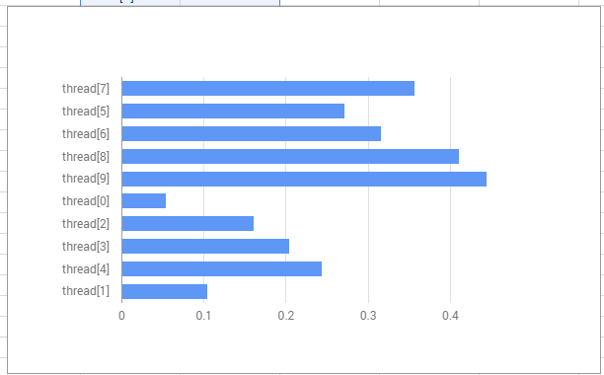
MPI 8 threads

Slide 20
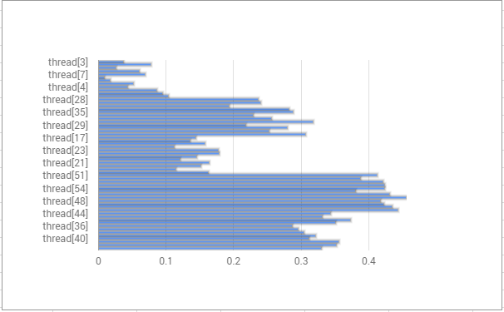
MPI 60 threads

Slide 21
OpenMP
thread[0] = 10.338265895843505859375
thread[1] = 13.29946994781494140625
thread[1] = 12.9938290119171142578125
thread[2] = 13.2419159412384033203125
thread[1] = 12.267545223236083984375
thread[0] = 12.2956941127777099609375
thread[1] = 12.292892932891845703125
thread[1] = 11.872180938720703125
thread[4] = 13.4783980846405029296875
thread[4] = 13.8721408843994140625
thread[1] = 12.8840191364288330078125
thread[0] = 14.3195438385009765625
thread[3] = 13.84622097015380859375
thread[3] = 14.2419230937957763671875
thread[0] = 13.413174152374267578125
thread[0] = 15.2872169017791748046875
thread[0] = 13.5199549198150634765625
thread[2] = 13.5350239276885986328125
thread[2] = 14.8349530696868896484375
thread[2] = 14.7811949253082275390625
thread[1] = 15.1787149906158447265625
thread[4] = 14.46957683563232421875

Slide 22
Conclusion
MPI is the fastest among all the 3.
I have observed that as the number of threads increases the total execution time slightly reduces.
I think this is because, this is a pure iterative process, the more number of people to help, the faster we can complete the problem.

Slide 23
THANK YOU

